Slide 3
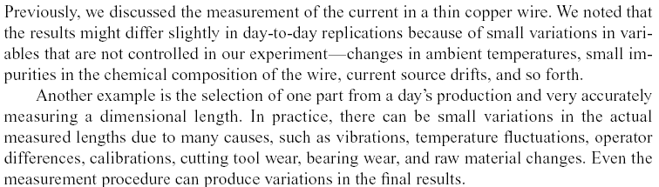
4-1 Continuous Random Variables

Slide 4
4-2 Probability Distributions and Probability Density Functions
Figure 4-1 Density function of a loading on a long, thin beam.

Slide 5
4-2 Probability Distributions and Probability Density Functions
Figure 4-2 Probability determined from the area under f(x).

Slide 6
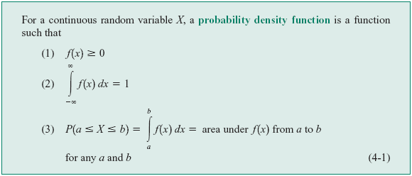
4-2 Probability Distributions and Probability Density Functions
Definition

Slide 7
4-2 Probability Distributions and Probability Density Functions
Figure 4-3 Histogram approximates a probability density function.

Slide 8
4-2 Probability Distributions and Probability Density Functions

Slide 9
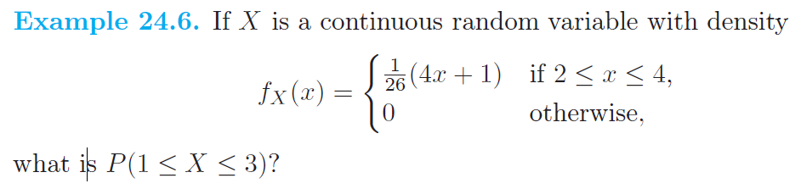
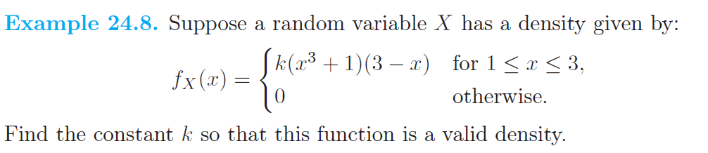
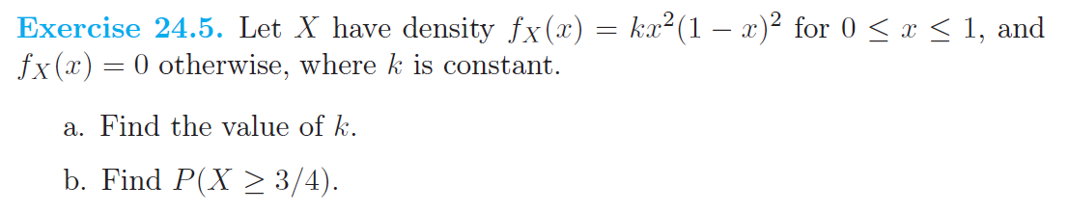

Slide 10
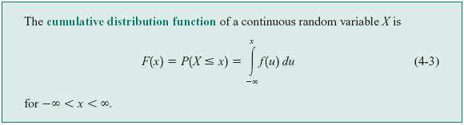
4-3 Cumulative Distribution Functions
Definition

Slide 11
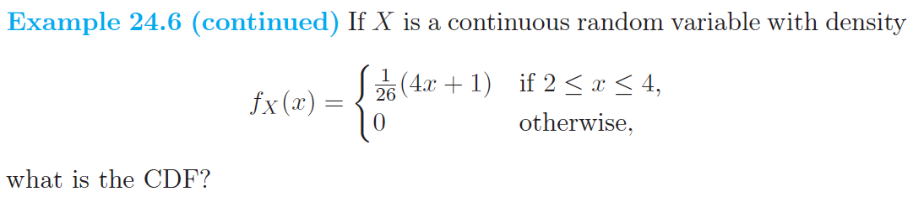
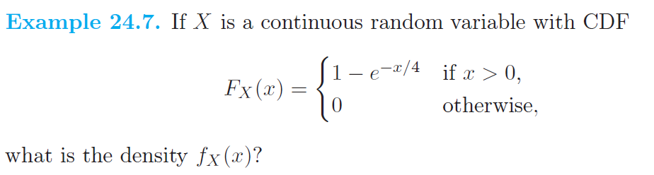
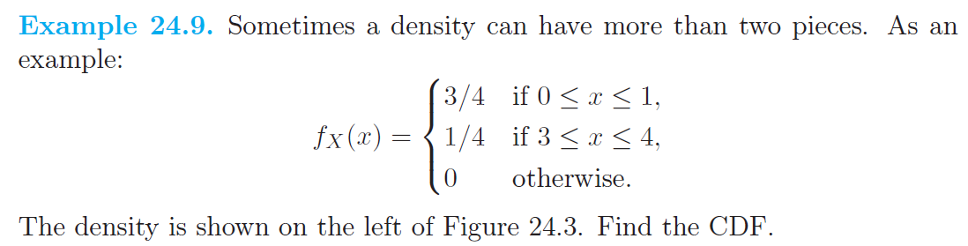

Slide 12
4-4 Mean and Variance of a Continuous Random Variable
Definition

Slide 13
4-4 Mean and Variance of a Continuous Random Variable
Expected Value of a Function of a Continuous Random Variable

Slide 14
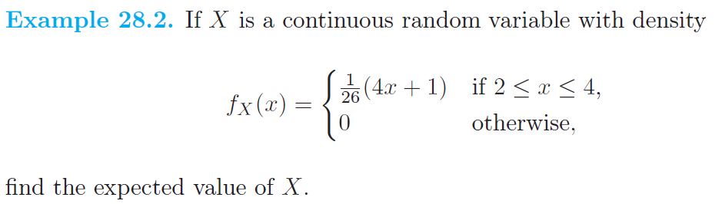
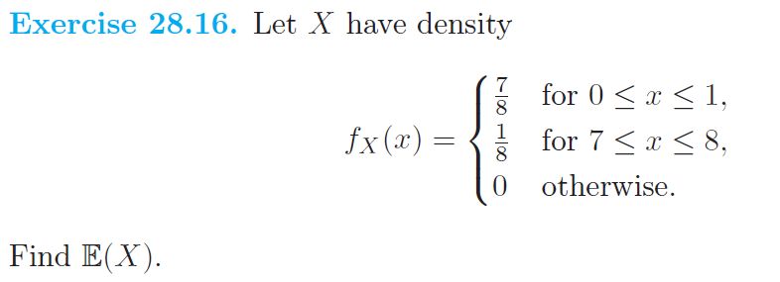

Slide 15
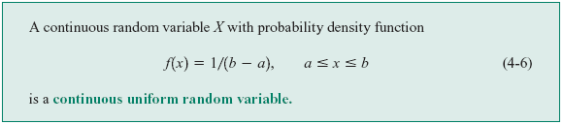
4-5 Continuous Uniform Random Variable
Definition

Slide 16
4-5 Continuous Uniform Random Variable
Figure 4-8 Continuous uniform probability density function.

Slide 17
4-5 Continuous Uniform Random Variable
Mean and Variance

Slide 18
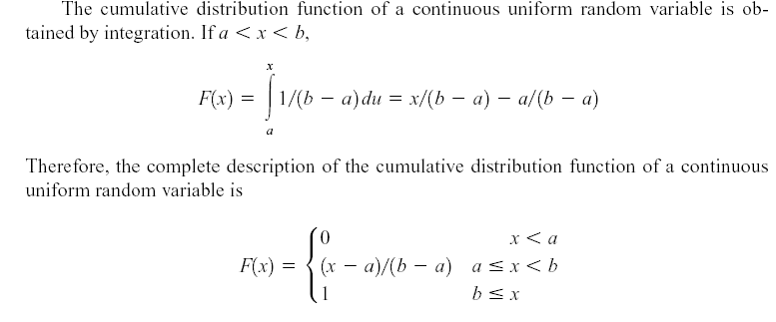
4-5 Continuous Uniform Random Variable

Slide 19
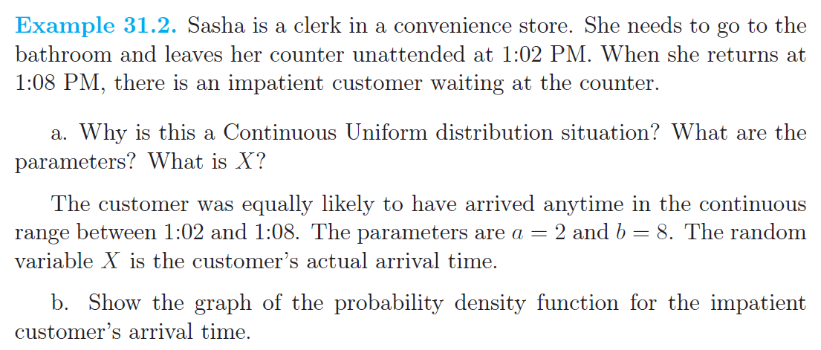

Slide 20
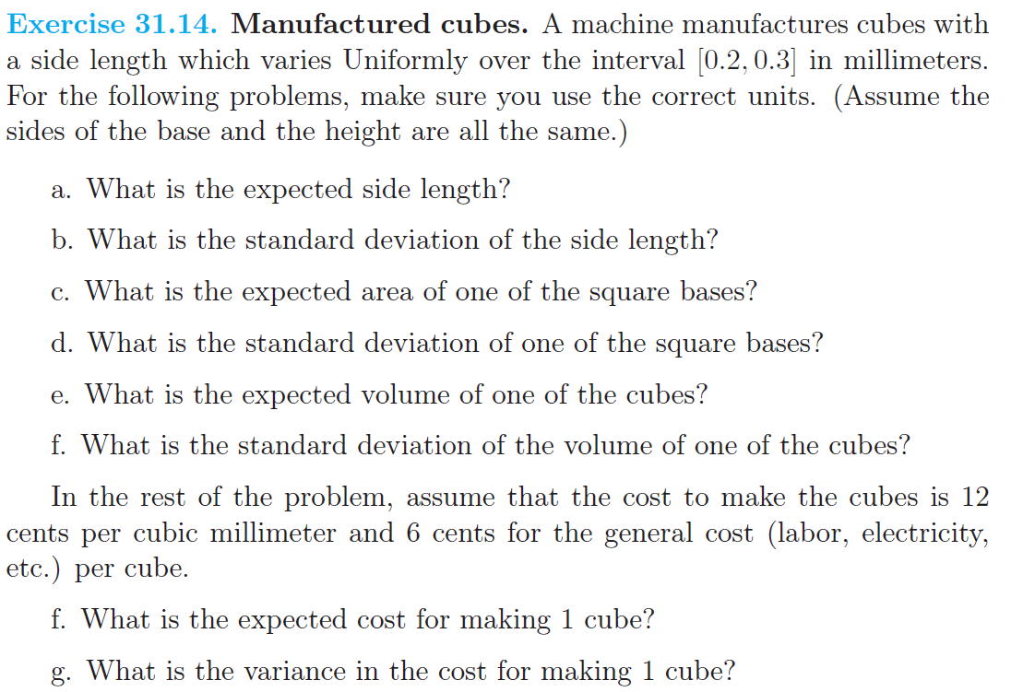

Slide 21
4-6 Normal Distribution
Definition

Slide 22
4-6 Normal Distribution
Figure 4-10 Normal probability density functions for selected values of the parameters μ and σ².

Slide 23
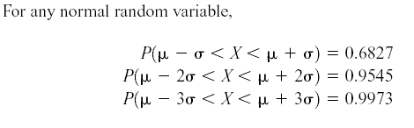
4-6 Normal Distribution
Some useful results concerning the normal distribution

Slide 24
4-6 Normal Distribution
Definition : Standard Normal

Slide 25
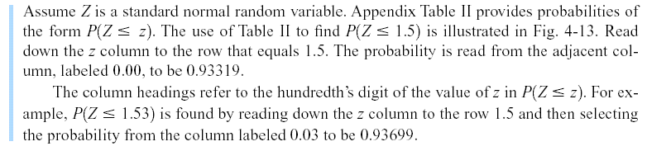
4-6 Normal Distribution
Example 4-11
Figure 4-13 Standard normal probability density function.

Slide 26
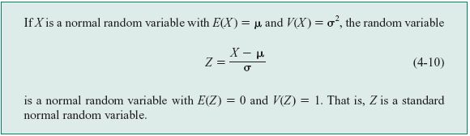
4-6 Normal Distribution
Standardizing

Slide 27
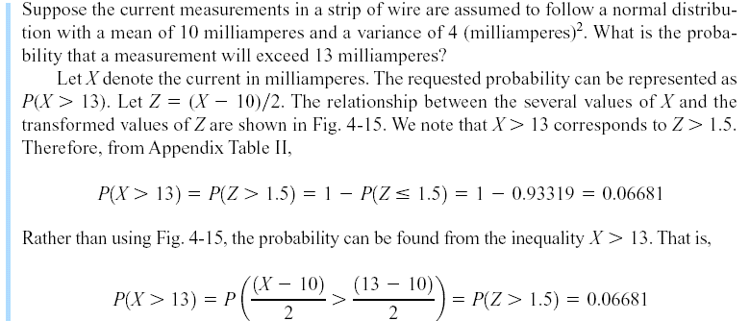
4-6 Normal Distribution
Example 4-13

Slide 28
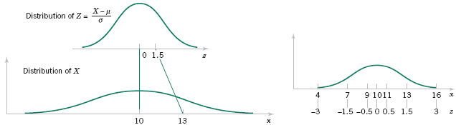
4-6 Normal Distribution
Figure 4-15 Standardizing a normal random variable.

Slide 29
4-6 Normal Distribution
To Calculate Probability

Slide 30
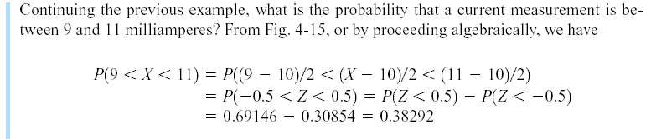
4-6 Normal Distribution
Example 4-14

Slide 31
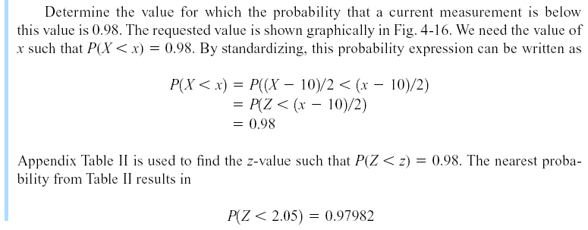

4-6 Normal Distribution
Example 4-14 (continued)

Slide 32
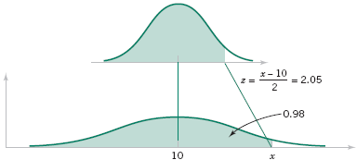
4-6 Normal Distribution
Example 4-14 (continued)
Figure 4-16 Determining the value of x to meet a specified probability.

Slide 33
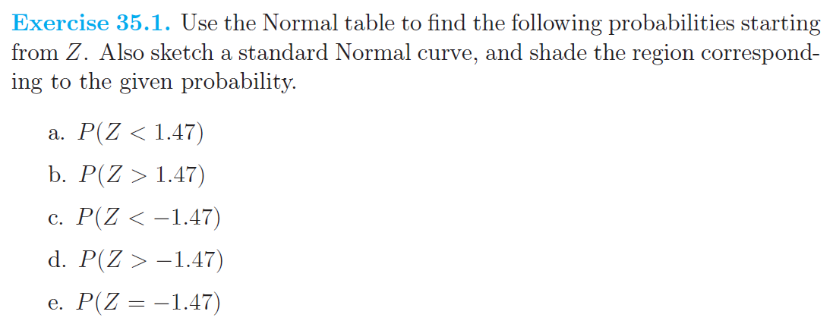
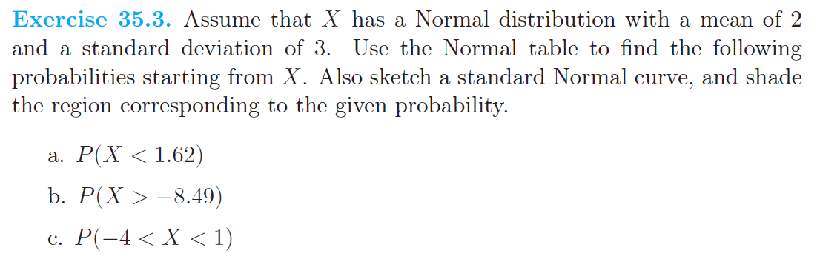

Slide 34
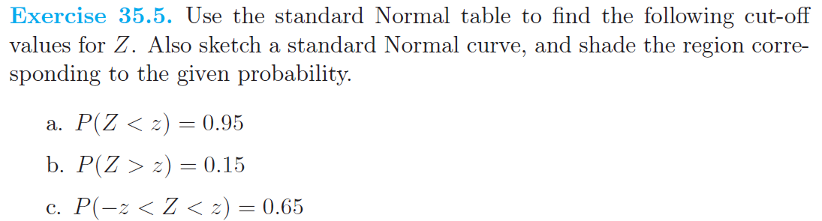
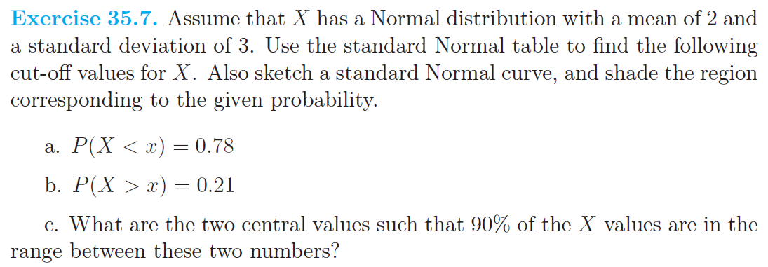

Slide 35
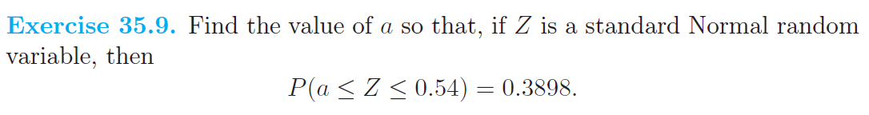
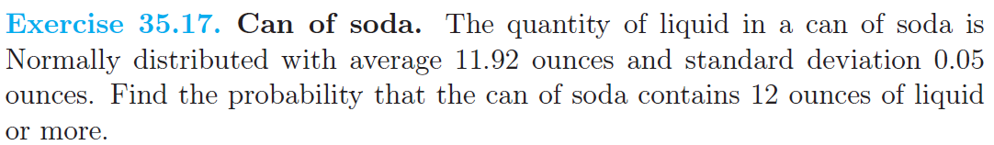

Slide 36
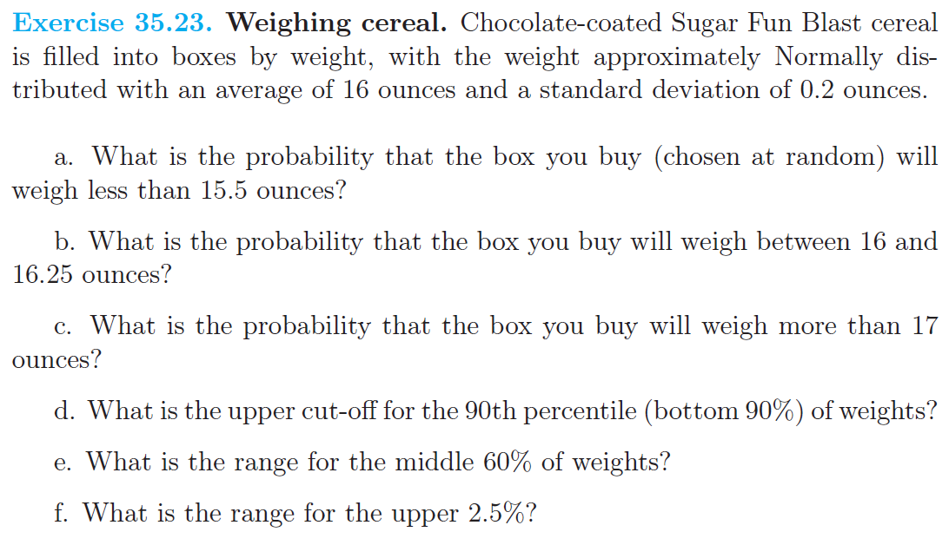

Slide 37
4-7 Normal Approximation to the Binomial and Poisson Distributions
Under certain conditions, the normal distribution can be used to approximate the binomial distribution and the Poisson distribution.

Slide 38
4-7 Normal Approximation to the Binomial and Poisson Distributions
Figure 4-19 Normal approximation to the binomial.

Slide 39
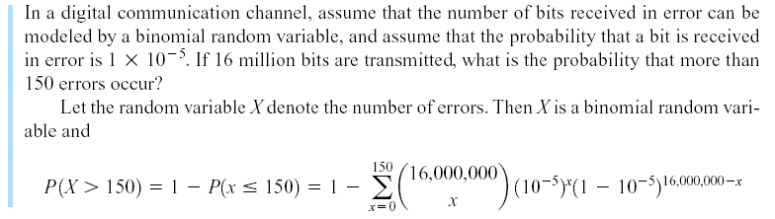
4-7 Normal Approximation to the Binomial and Poisson Distributions
Example 4-17

Slide 40
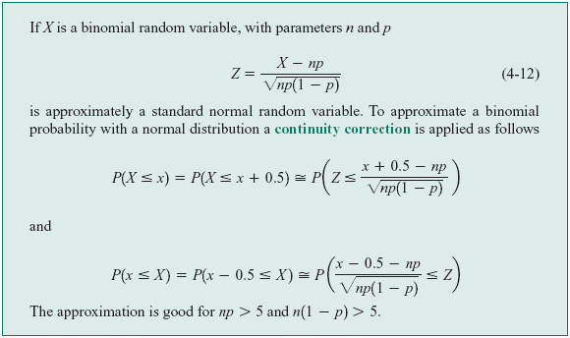
4-7 Normal Approximation to the Binomial and Poisson Distributions
Normal Approximation to the Binomial Distribution

Slide 41
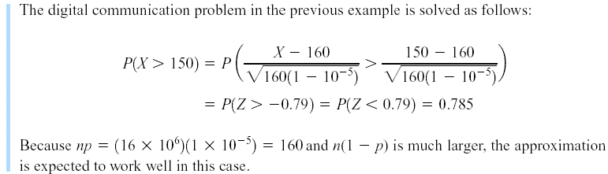
4-7 Normal Approximation to the Binomial and Poisson Distributions
Example 4-18

Slide 42

4-7 Normal Approximation to the Binomial and Poisson Distributions
Figure 4-21 Conditions for approximating hypergeometric and binomial probabilities.

Slide 43
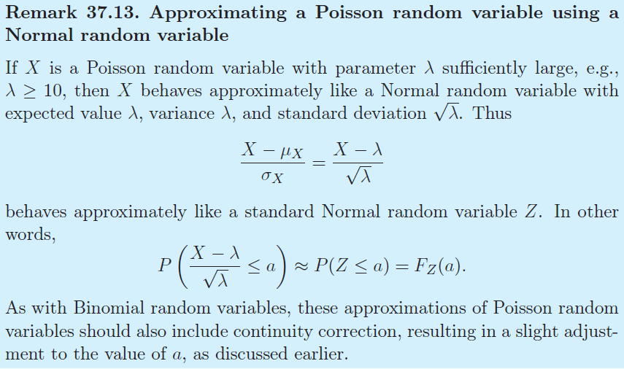
4-7 Normal Approximation to the Binomial and Poisson Distributions
Normal Approximation to the Poisson Distribution

Slide 44
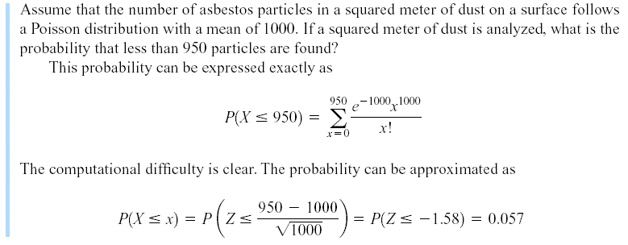
4-7 Normal Approximation to the Binomial and Poisson Distributions
Example 4-20

Slide 45
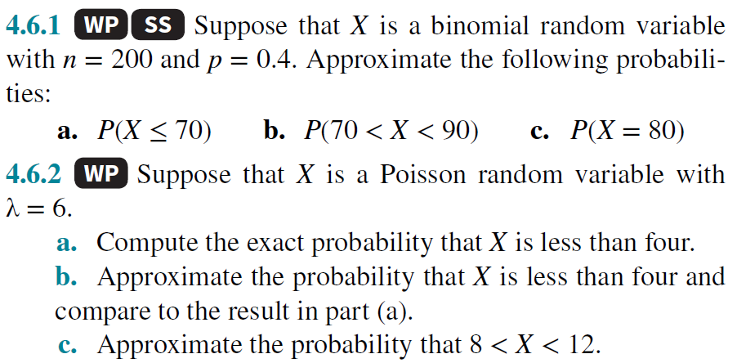
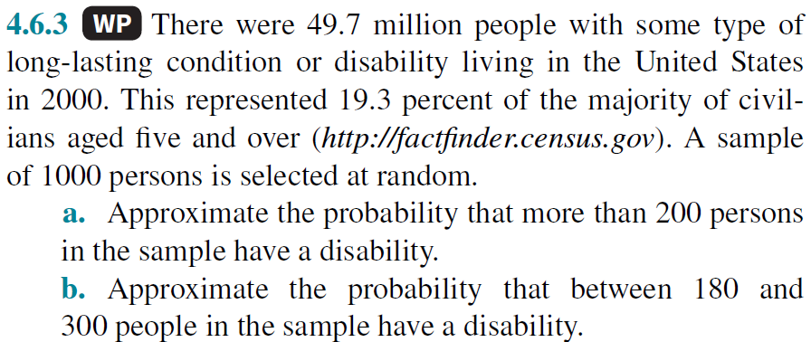

Slide 46
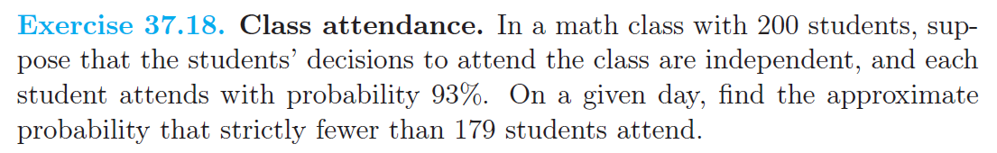
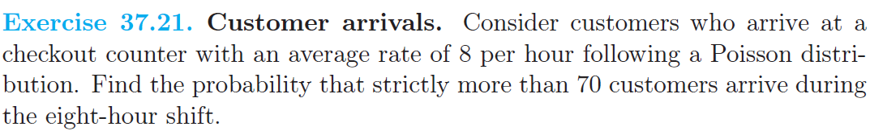

Slide 47
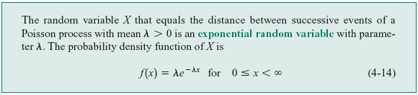
4-8 Exponential Distribution
Definition

Slide 48
4-8 Exponential Distribution
Mean and Variance

Slide 49
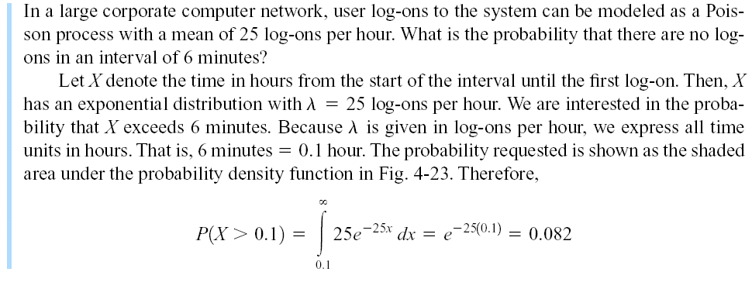
4-8 Exponential Distribution
Example 4-21

Slide 50
4-8 Exponential Distribution
Figure 4-23 Probability for the exponential distribution in Example 4-21.

Slide 51
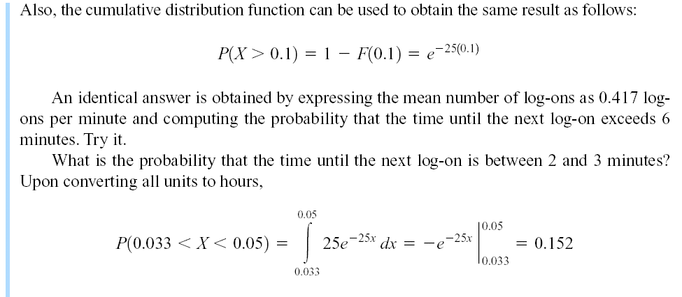
4-8 Exponential Distribution
Example 4-21 (continued)

Slide 52
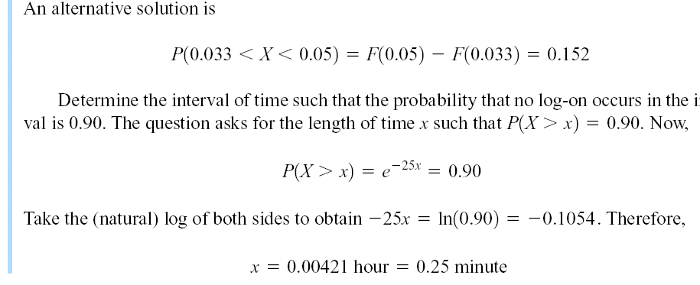
4-8 Exponential Distribution
Example 4-21 (continued)

Slide 53
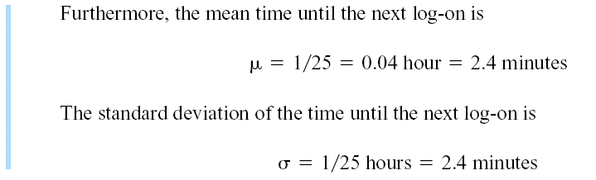
4-8 Exponential Distribution
Example 4-21 (continued)

Slide 54
4-8 Exponential Distribution
Our starting point for observing the system does not matter.
An even more interesting property of an exponential random variable is the lack of memory property.
In Example 4-21, suppose that there are no log-ons from 12:00 to 12:15; the probability that there are no log-ons from 12:15 to 12:21 is still 0.082. Because we have already been waiting for 15 minutes, we feel that we are “due.” That is, the probability of a log-on in the next 6 minutes should be greater than 0.082. However, for an exponential distribution this is not true.

Slide 55
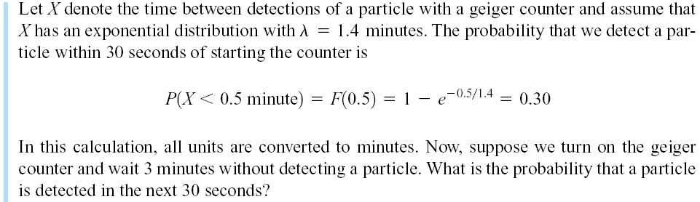
4-8 Exponential Distribution
Example 4-22

Slide 56
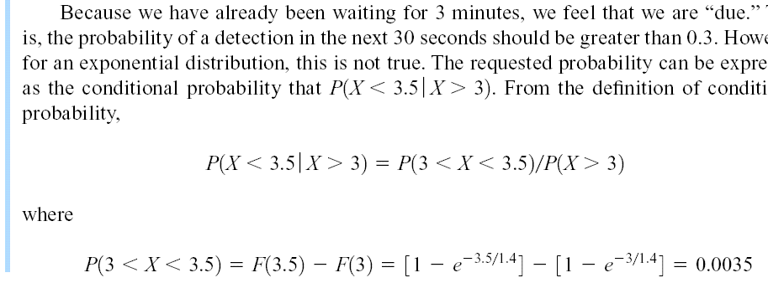

4-8 Exponential Distribution
Example 4-22 (continued)

Slide 57
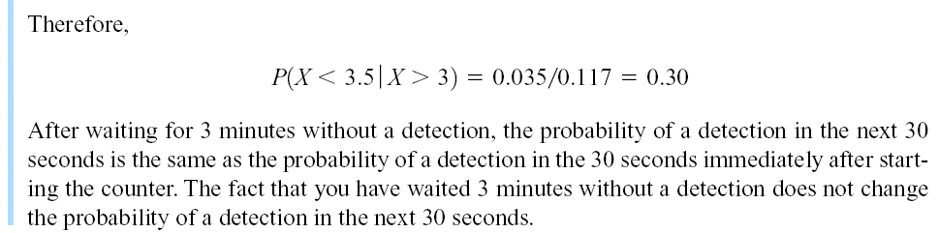
4-8 Exponential Distribution
Example 4-22 (continued)

Slide 58
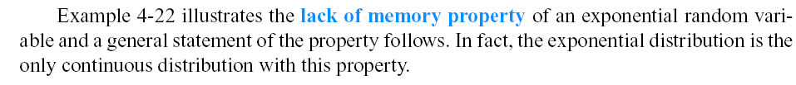

4-8 Exponential Distribution
Lack of Memory Property

Slide 59
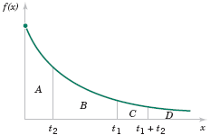
4-8 Exponential Distribution
Figure 4-24 Lack of memory property of an Exponential distribution.

Slide 60
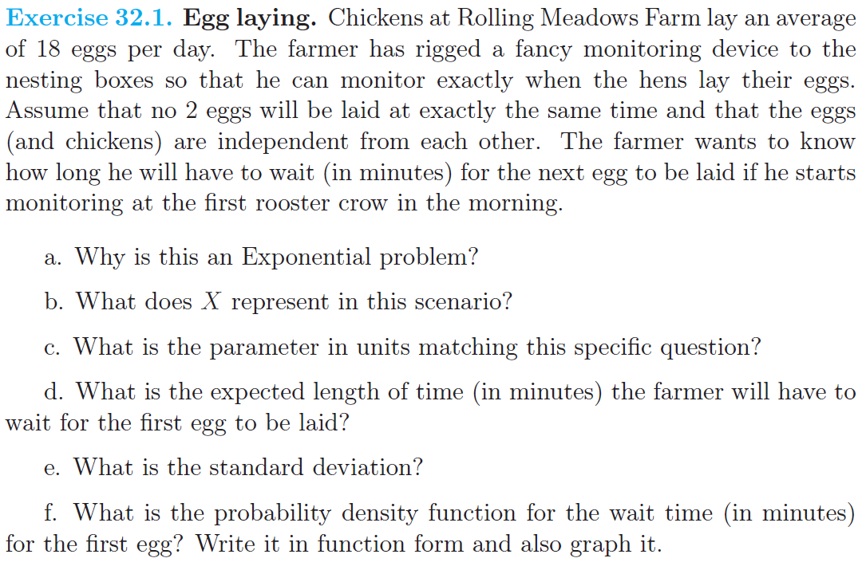

Slide 61


Slide 62



